Slide 1
PREDICTING REVENUE
Chou Khang

Slide 2
Overview
With today’s ever-changing market and competitors aiming to overtake the industry, more than ever analyst are using machine to aid in better decision making.
The use of machine learning can produce more accurate forecast and find complex correlations. Thus, giving companies an edge where lacking.
Taking the concept above, my project aims at predicting revenue for my current employer

Slide 3

Steps and Processes
Extracting Data
The chart on the left explains each process in predicting revenue
Cleaning Data
Training and Testing
(input)
Prediction
(output)

Slide 4

Extracting Data
First, figuring out what data to use.
Obtained data from 3 separate databases
IRI
Great Plains
Book keeper
Combined data in excel

Slide 5
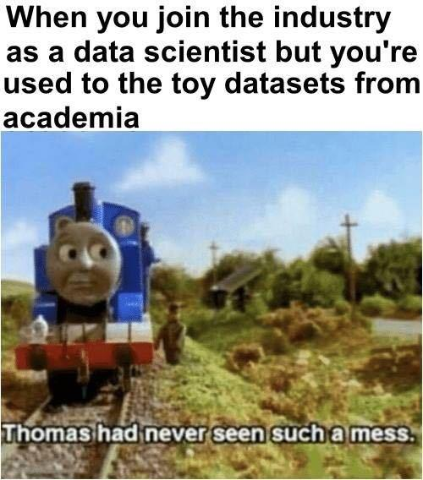
Cleaning Data
Used excel and python to clean data
Excel to merge
Python to format data
Float vs String
Decimal points (mapping)
Dropping columns

Slide 6
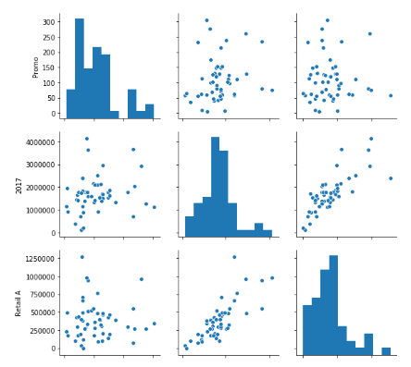
Training and Testing
First charting to find correlations
Fitting data to model (randomforest)
Why Randomforest
Correlations
Flexibility
Ability to fine tune
Training and testing data
After results, scaled data to bring test % up
MinMaxScaler
StandardScaler

Slide 7


predicion
Prediction is at 20%
Still low so utilize time-series (fbProphet) to compare with randomforest
Dropping columns with low correlation
Re-training

Slide 8
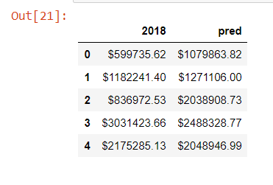
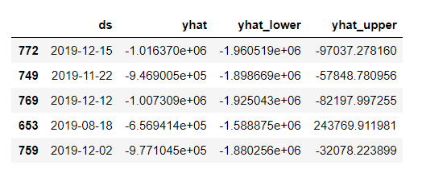
Output
Random Forest
vs
Time Series

Slide 9
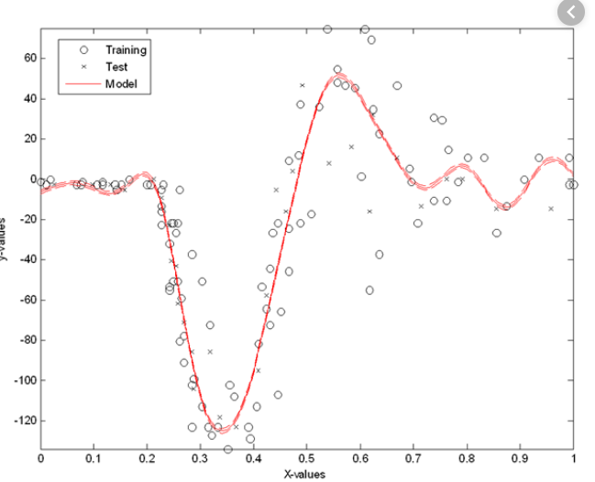
Conclusion
Need better data
Utilize Support Vector Machine

Slide 10
End
Thank you

